Slide 1
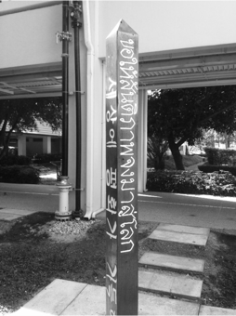
Mother Tongue Program
2015 - 2016

Slide 2
Introduction – my background
Languages in the world today x 2 – group tasks
Bilingualism: Fact and Fiction – group tasks
Mother tongue at ISB
Future possibilities

Slide 3
My background
Elementary and EAL trained teacher
Teacher educator (EAL) and Associate Dean – University of Sydney
EAL teacher in Australia, Pakistan, Japan, Indonesia and here at ISB
My Doctorate looked at designing effective learning for bilingual children
My wife Carmel is the Grade 6 Counsellor

Slide 4
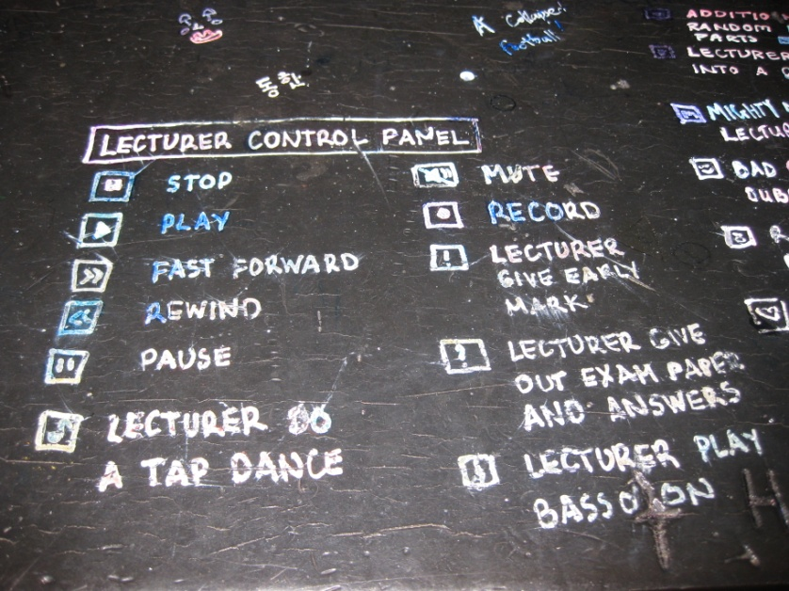

Slide 5
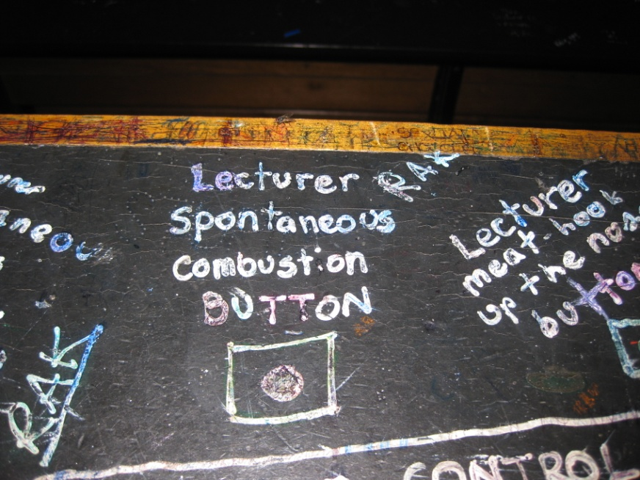

Slide 6
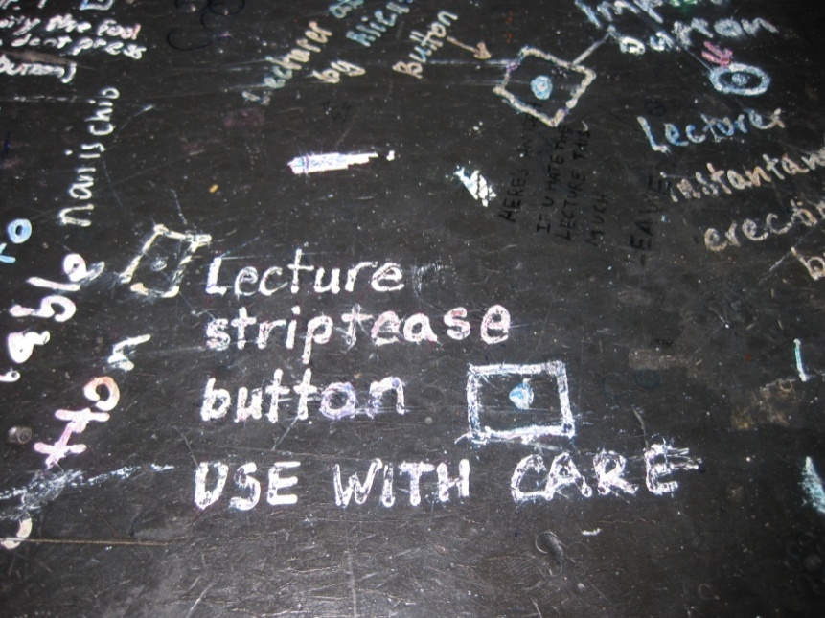

Slide 7
Focussing on Language (s)
How many living languages? (group task)
Top 10 languages? (group task)

Slide 8
Answers
How many living languages?
More than 7000

Slide 9
Top 10 languages…..
Chinese
Spanish
English
Hindi
Arabic
Portuguese
Bengali
Russian
Japanese
Lahnda

Slide 10
Bilingualism

Slide 11
Two short tasks:
What percentage of the world’s population is bilingual? (estimate with your partner)
What does bilingual mean?
(write a short definition of what it means to be bilingual)

Slide 12
………. the majority of the world's population is bilingual or multilingual. In a survey conducted by the European Commission in 2006, 56 percent of respondents reported being able to speak in a language other than their mother tongue. Oct 31, 2012 The Cognitive Benefits of Being Bilingual - Dana Foundation dana.org/Cerebrum/2012/The_Cognitive_Benefits_of_Being_Bilingual/

Slide 13
Bilingualism
Bilingualism is commonly defined as the use of at least two languages by an individual (ASHA, 2004). It is a fluctuating system in children and adults whereby use of and proficiency in two languages may change depending on the opportunities to use the languages and exposure to other users of the languages. It is a dynamic and fluid process across a number of domains, including experience, tasks, topics, and time.

Slide 14
Speaking more than one language
https://www.youtube.com/watch?v=3KswIJwGknA
Bilingualism: Fact and Fiction (group task)

Slide 15
Fiction
An individual must learn a second language as a young child in order to become bilingual.
Parents should adopt the “one parent-one language” approach when exposing their child to two languages.
If you want your child to speak the majority language, you should stop speaking your home language with your child.

Slide 16
Fiction (cont.)
Bilingualism causes language delay.
When children mix their languages it means that they are confused and having trouble becoming bilingual.
A person is not truly bilingual unless he is equally proficient in both languages.

Slide 17
Fact
Bilingualism actually grows grey matter!
Bilingualism can help to ward off the mental ageing process
Bilingualism is increasingly common in today’s world.
Bilingual children do better in education

Slide 18
Fact (cont.)
Bilingual children do NOT often struggle with ‘language confusion’
Bilinguals are not always equally proficient in both languages
You can still learn a language as an adult!
Bilingual promotes all areas of cognitive functioning.
Bilinguals are better listeners
Bilingualism encourages people to think globally.

Slide 19
Linguistic Snapshot
At ISB over half the student population speak a language other than English
From Pre-K - 12, over 40 languages are spoken in our school
After Thai and English, some of the larger language groups include: Japanese / Korean / Hebrew / Spanish and Hindi

Slide 20
Mother Tongue Classes at other International Schools
Similar to ISB:
International School of Dusseldorf
International School of Hamburg
International School Copenhagen
Yokohama International School
International School of Lausanne
International School of Phnom Penh

Slide 21
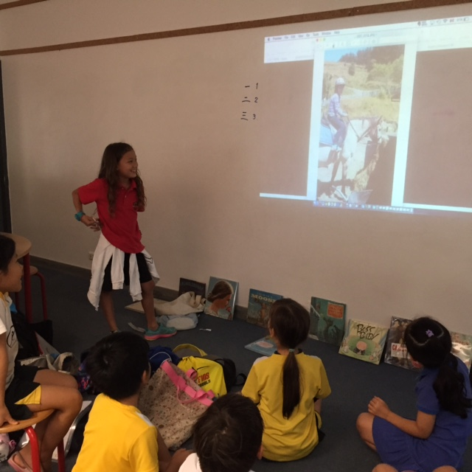
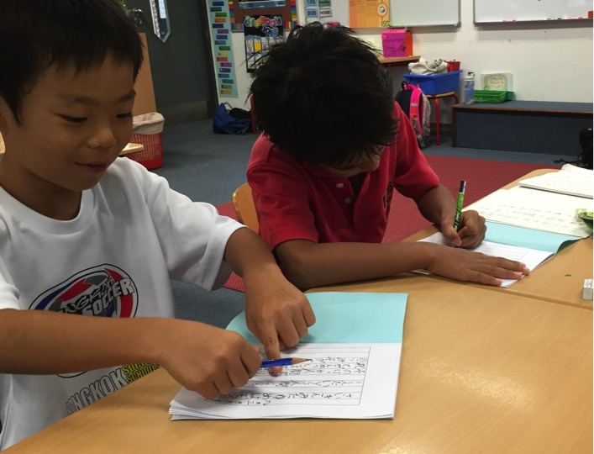
Current mother tongue support
Japanese

Slide 22
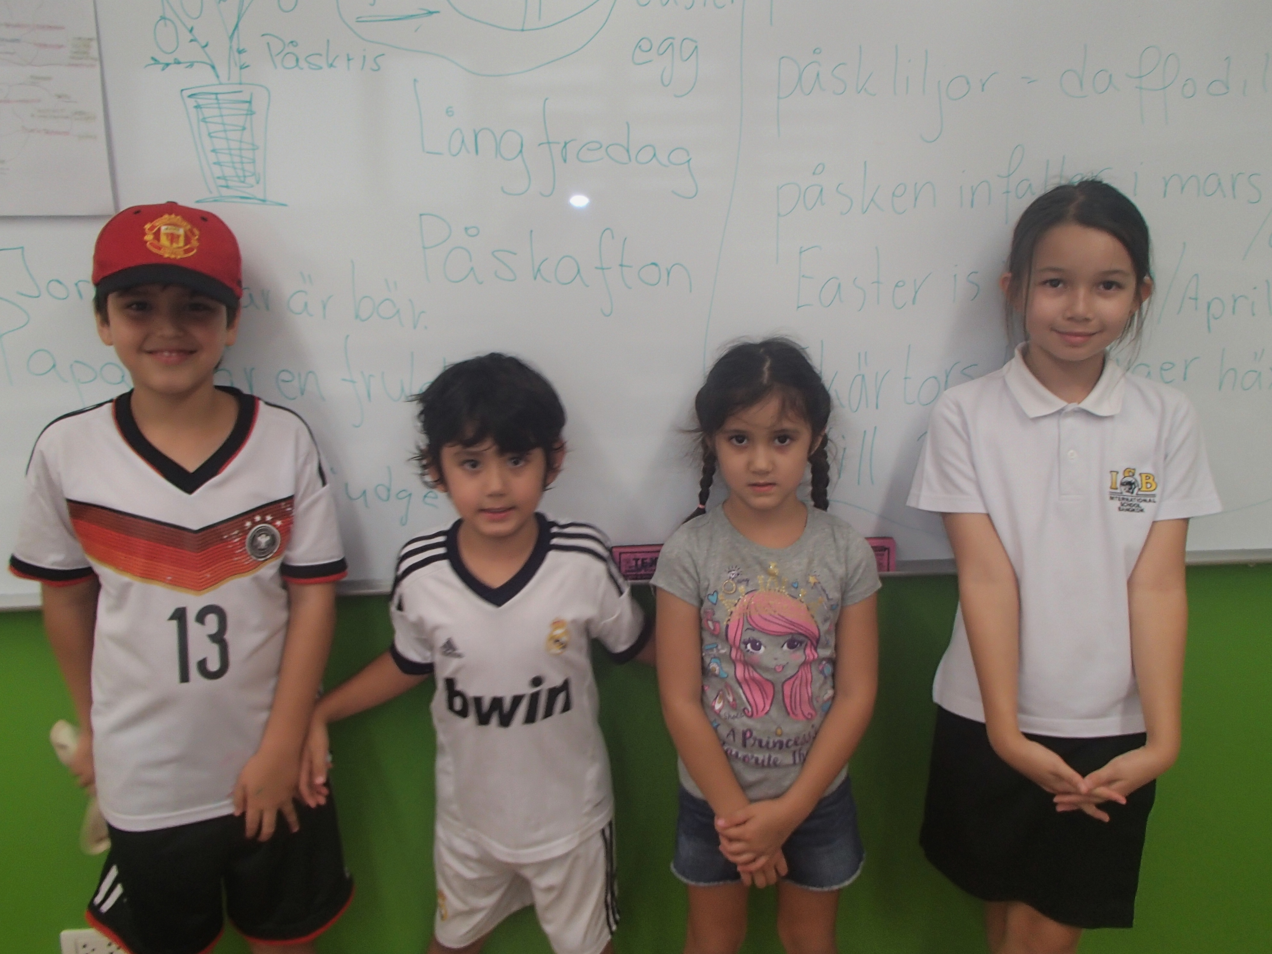
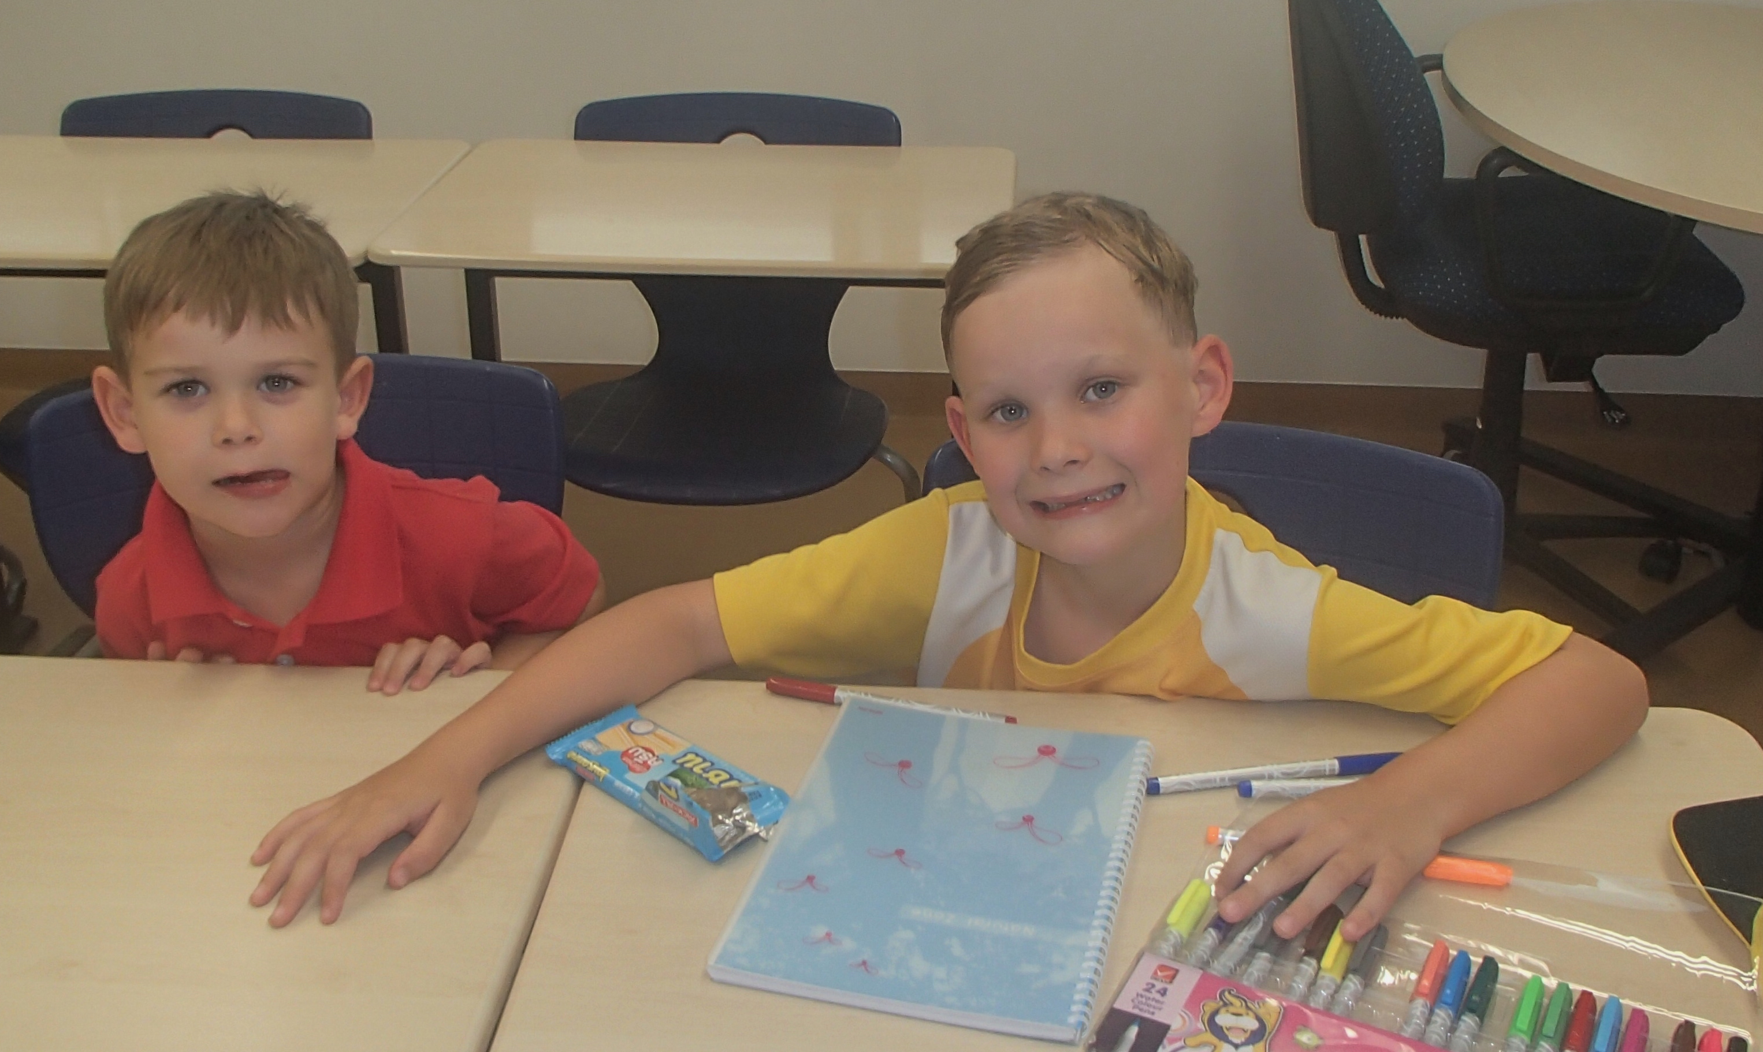
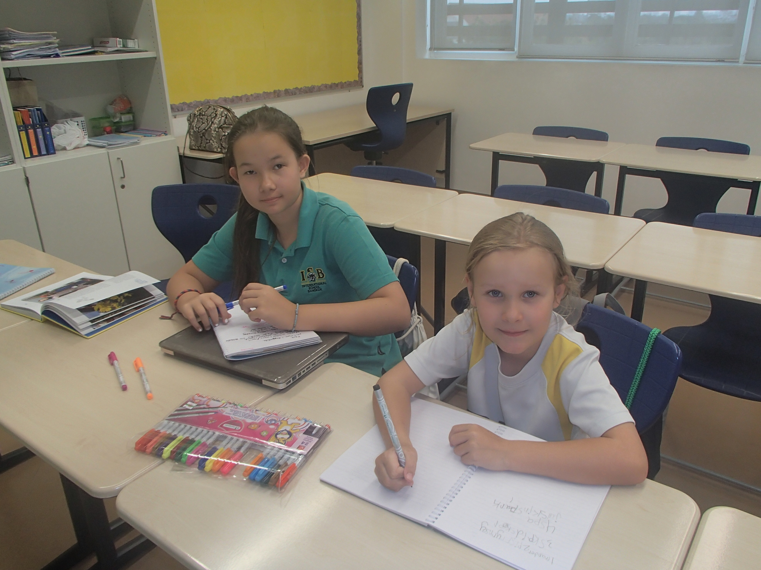
Swedish

Slide 23
Dutch (ES / MS)
Chinese (ES / MS)
French (ES)
Korean Pre-IB / Korean ES (March 1st)
Danish (ES / MS)
German (ES)

Slide 24
Some background….
Location: generally in the Cultural Centre but some (Chinese ES / Japanese ES) in classrooms
Cost: usually around 600 baht / hour / student
Fees: go to the teacher (income for ISB staff is taxed according to school policy and Thai law)

Slide 25
What does ISB contribute?
Rooms and utilities
Classroom material (when requested) – pens, paper, notebooks, plastic folders
Taxi fares / transport costs where appropriate

Slide 26
Text books where needed (around $300) + printing of worksheets
Child safe guarding training
Interviews to assess qualifications
Coordination and administrative support

Slide 27
Future Possibilities….
In classrooms – multilingual perspectives
http://www.thetelegraphandargus.co.uk/news/9554958.140_languages_spoken_by_pupils_in_district_bring_classroom_challenges/
Teacher professional development (e.g. attending conferences / presenting papers etc)

Slide 28
Further integration into the nature of the school
Bilingual signage
Parent and teacher MT meetings
Mother tongue in school time

Slide 29
Mother tongue in school time
Issues:
Number of students
Teacher availability
Equity / diverse nature of the school population
Schedule re-organisation
MS initiatives – scheduling and where to place in timetable

Slide 30
ISB mother tongue blog
http://inside.isb.ac.th/mothertongue/
http://inside.isb.ac.th/mothertongue/

Slide 31
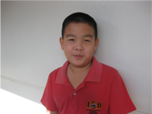
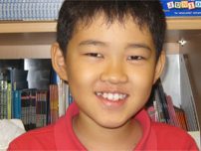
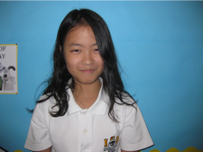
“I was worried that my children got lost their
mother language so fast since we've moved here.” ^{Email from parent 11.11.2015}

Slide 32
Thank you… Dr Paul Dufficy paul@isb.ac.th

